Slide 1


Alberta region
“How did we put research into action?”
Year four & five knowledge translation & dissemination activities
SSHRC/CURA Annual Team Meeting
Friday, June 17, 2016
Luther College
University of Regina, Regina, Saskatchewan
Notes:
Alberta Region
“How did we put research into action?”
Year four & five knowledge translation & dissemination activities

Slide 2
Year Four and five knowledge translation overview
COMMUNITY REPORT
RESOLVE NEWSLETTER ARTICLES
LOCAL & INTERNATIONAL CONFERENCES
MEDIA WORKSHOPS
TELECONFERENCE MEETINGS
PUBLICATIONS FOR ACADEMIC JOURNALS
Notes:
“How did we put research into action?”
-this is an overview of our Year 4 and 5 Knowledge Translation activities
- We developed a COMMUNITY REPORT, RESOLVE NEWSLETTER ARTICLES, presented at LOCAL & INTERNATIONAL CONFERENCES, attended MEDIA WORKSHOPS, held TELECONFERENCE MEETINGS
with interested community agency, and have written manuscripts for PUBLICATIONS FOR ACADEMIC JOURNALS, as well as assisted others regionally in their writing.

Slide 3
Research questions
What are the needs of women who experience intimate partner violence in rural and northern regions of Canada?
What are the gaps in meeting these needs?
How do we create and sustain non-violent communities in rural and northern regions of Canada?
Notes:
These research questions were answered through the Year 2 Interviews and Year 3 Focus groups:
What are the needs of women who experience intimate partner violence in rural and northern regions of Canada?
What are the gaps in meeting these needs?
How do we create and sustain non-violent communities in rural and northern regions of Canada?
Findings from these data analyses were transformed into a Alberta Research Project Report for Provincial Stakeholders, which we will discuss next.

Slide 4
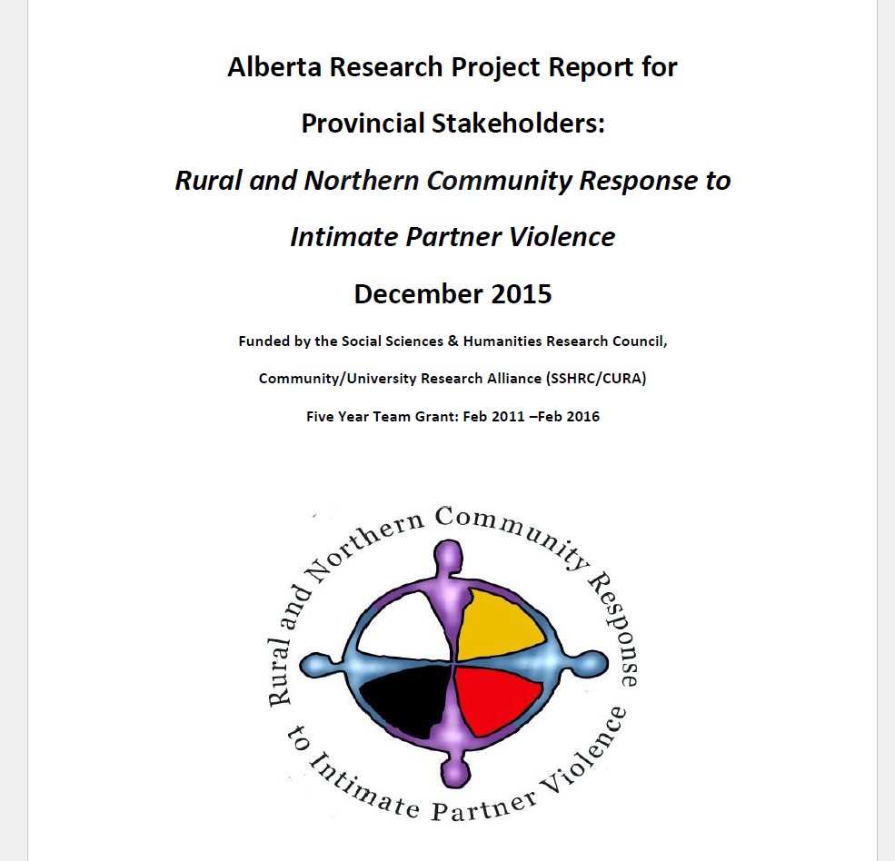
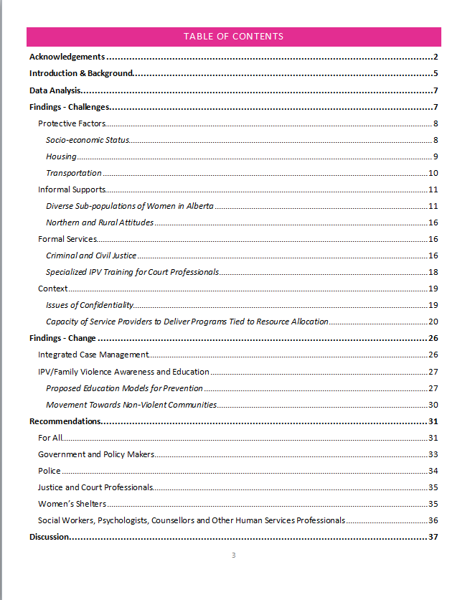
Notes:
We combined all data into our Alberta Research Project Report for Stakeholders (AKA our Community Report); we only referenced the Environmental Scan, but this report captures our GIS map, Year 2 Individual Interview Data and Year 3 Focus Group data triangulated together; presenting our key findings and recommendations.
-This report has already been disseminated within the 4 regions, but now we will discuss the dissemination of this report

Slide 5
Knowledge Translation Utilizing Community Report
Community Report to Stakeholders
Distribution
Research Participants &
Interested Conference Attendees
Share and utilize findings within organization
Disseminate report to colleagues within organization and beyond
Community Organizations &
Government Ministries
Disseminate within circles of influence
Ministries: Human Services & Status of Women
Notes:
Our Community Report , ’ Alberta Research Project Report for Provincial Stakeholders: Rural and Northern Community Response to Intimate Partner Violence was chosen as a vehicle for knowledge translation:
First and foremost, this community report was developed in collaboration with the research team, refined with feedback from research participants, then finalized and printed.
-The entire Alberta research team worked together to develop key findings to be included in the report, as well as recommendations
-our Community Research Partner edited and re-vamped the format, recommendations and discussion section after initial feedback
-the project coordinator and academic lead finished the final editing and formatting
-Once it was in a final draft form this was emailed out to the focus group participants in two focus communities for their feedback regarding content of the report
-This feedback was incorporated into the final draft and then finalized
The distribution of the community report has been pivotal in our knowledge translation of the research findings.
-The community report was printed in February 2016 and mailed out to all individual interview research participants and the focus group participants with an accompanying cover letter as a way to communicate the results.
-Ann also posted the report in pdf form on the public side of the RNCR website for further dissemination, we pasted this link on the inside cover of the Community Report so that those who received the report and wanted to share it with colleagues had a way to do so.
-In addition, interested conference attendees, community organizations (that have been interested in our project), and relevant government ministries (i.e. Human Services and Status of Women) were mailed or emailed depending upon the contact information provided.
Finally, this initial dissemination spurred further distribution of the report when recipients shared and utilized findings within their organization and within their circles of influence, disseminated the report to colleagues within and beyond their organizations; interested community organization disseminated the report; government ministries responded in the form of written letters.
-For example, one person was a Program/Policy Specialist from the Government of Newfoundland/Labrador and mentioned that it is timely to her work and that she distributed it among her colleagues within and outside her department

Slide 6
Example Cover Letter that Accompanied the Community Report
Notes:
The accompanying cover letter was also part of our knowledge dissemination strategy to encourage recipients to share results, raise awareness, and mobilize community action utilizing the community report.
“On behalf of the Social Sciences Health Research Council/Community University Research Alliance (SSHRC/CURA) research team, I am pleased to share our Alberta Research Project Report for Provincial Stakeholders: Rural and Northern Community Response to Intimate Partner Violence with you.
This report to the community describes the research project, generally, as well as the findings that have enhanced our understanding of effective community response to intimate partner violence (IPV) in rural and northern regions of Alberta. IPV service providers from 10 rural and northern communities in Alberta participated through interviews and focus groups. This report outlines the needs of women who experience IPV and the gaps in meeting these needs. It also includes the visions of participants toward creating and sustaining nonviolent communities in Alberta.
A number of valuable recommendations were developed to guide future directions and initiatives at front-line and community levels, as well as beyond. A pdf version of this report is also available at http://www2.uregina.ca/ipv/research.html if you would like to share this with others that may be interested.
By involving stakeholders in this research from the beginning, it is our hope that the research findings are usable and that the sharing of them in the form of this report will mobilize the information, ultimately leading to policy changes. Service providers in all of our focus communities were eager to share not only their concerns and frustrations with systemic and budgetary issues, but they were also eager to share their ideas, recommendations for change, present experiences and hopes for the future. While enormous strides have been made in assisting women experiencing IPV in Alberta, our rural and northern communities are underfunded in a number of human services sectors, such as prioritizing context-specific IPV prevention and intervention initiatives. It is our sincere desire to continue to work towards nonviolent communities by implementing these recommendations for change and we look to you for your assistance in finding ways to do so. “

Slide 7
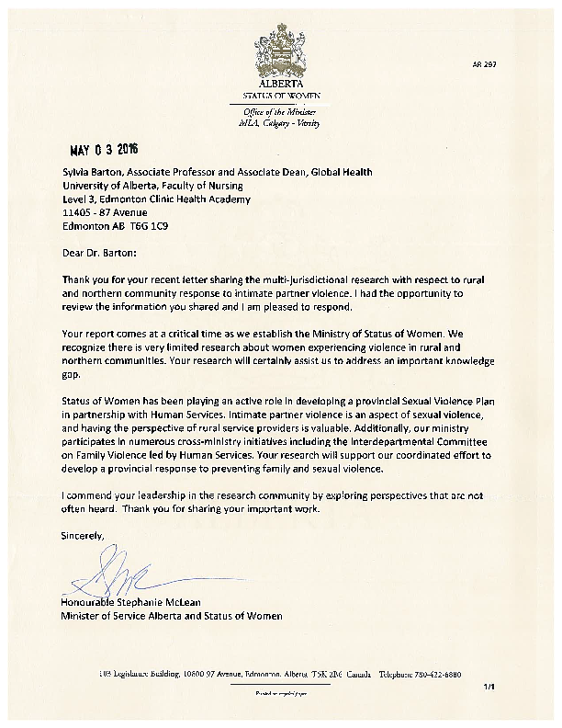
Letter in Response to Community Report from Ministry of Status of Women
Notes:
The community report informed policy makers to maximize policy change and community action to implement findings from our research.
-The Minister of the Status of Women commented that the report came at a critical time, as the Ministry of Status of Women is being established in Alberta
-she mentioned that currently they are developing a provincial strategy to address Sexual Violence in partnership with Human Services and our research findings will support their effort to develop a provincial response to preventing family and sexual violence

Slide 8
Notes:
In a letter from the Minister of Human Services, he commented that they are using a whole-government approach, a collective effort of all ministries to prevent, reduce, & end family violence and further explained that the Interdepartmental Committee on Family Violence is made up of relevant ministries – these all work together to provide a coordinated provincial response to address family violence.
This ministry has recognized the need to build stronger partnerships with rural remote communities and in this regard, they felt that our research holds many valuable insights and practical recommendations for Human Services, they will use the findings to inform and advance their work.
They also provided a contact if we wish to have further conversations to progress the research, Director of Program Delivery

Slide 9
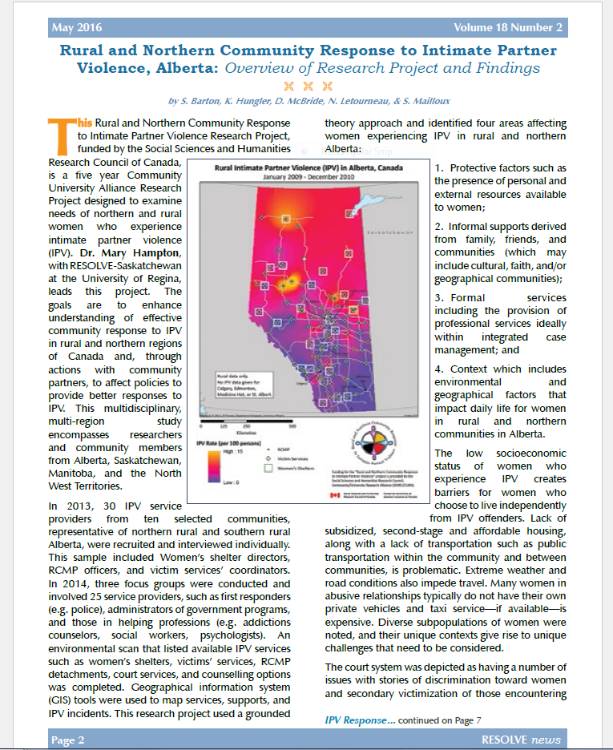
Resolve newsletter articles
Our overview of research project and findings article submission was published in the May 2016 RESOLVE Newsletter.
A second companion article may be published in an upcoming issue to follow up with recommendations.
Notes:
-Another way we disseminated research findings was through writing two articles for the RESOLVE newsletter. Our overview of research project and findings article submission was published in the May 2016 RESOLVE Newsletter.
-A second companion article may be published in an upcoming issue to follow up with research study recommendations.
-This newsletter reaches a wide provincial audience.

Slide 10

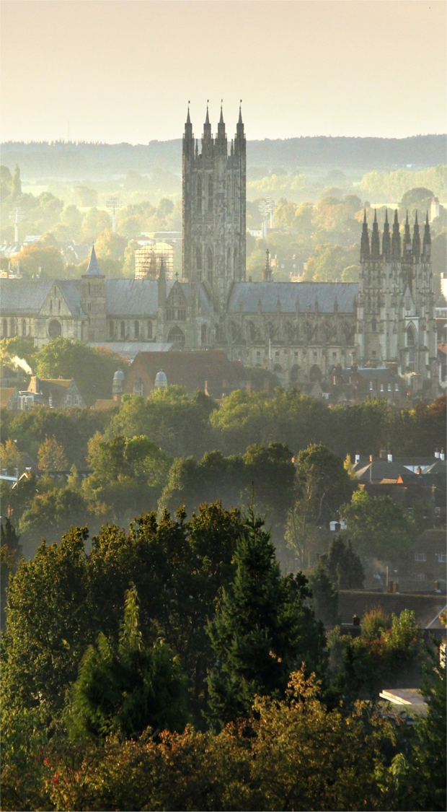

International conferences
Abstract: “Cultural Transitions in Rural and Northern Canada: Finding Solutions through New Care Directions for Women Experiencing Intimate Partner Violence”, the ICCHNR 2016 symposium: “Changing populations, changing needs: Directions and models for community orientated primary care”, Canterbury, England - September 15th - 16th, 2016. Poster presentation
Abstract: “Finding Solutions Together: Rural and Northern Community Response to Intimate Partner Violence in Alberta”, Canada 21st Nursing Network on Violence Against Women International Conference 2016, Melbourne, Australia – Oct 26-28, 2016, Oral paper presentation
Notes:
Two abstracts have been accepted for International Conferences to disseminate at a global level:
The first abstract entitled “Cultural Transitions in Rural and Northern Canada: Finding Solutions through New Care Directions for Women Experiencing Intimate Partner Violence”, at the ICCHNR 2016 symposium: “Changing populations, changing needs: Directions and models for community orientated primary care”, in Canterbury, England - September 15th - 16th, 2016. It is a poster presentation.
The second abstract is entitled: “Finding Solutions Together: Rural and Northern Community Response to Intimate Partner Violence in Alberta”, Canada 21st Nursing Network on Violence Against Women International Conference 2016, in Melbourne, Australia – Oct 26-28, 2016, and is an oral paper presentation.

Slide 11

Media workshop/webinar
The Art of Managing Media: Bahar Shadpour, January 26, 2016
Telling Your Research Story: Su-Ling Goh, Global News, April 14, 2016
Notes:
We also have drafted a media release and policy briefs along with attending media workshops to learn about approaches to engage the media:
We learned that for a number of reasons, the research findings may not work well with TV media, but may be more ammenable to other types of media:
--when you call the media it typically is a short turn around time – ‘day of’ shoot the video and the interview and it goes on the 6 oclock news
-the story needs to be important to viewers – viewers are typically concerned with: nutrition/fitness, aging issues/dementia, parenting/child health/Stollery hospital, common diseases
-TV is difficult, whatever the story is, it needs to be shown on video; if there are no visuals it does not make a good TV story
-must bring in the personal/emotional component, whoever is being interviewed needs to bring the personal relevance into it otherwise viewers do not trust what the person is saying
-when communicating with the media, it is good to keep it simple; however, reporters feel that it is their place to translate it into language viewers can readily understand; therefore, keep the depth of the story
-Grade 9 level, 2 minute stories with 20 second video clips; then reporters explains the rest
-for research they have even done stories re: study recruitment; explain the research and then let the public know that researchers are looking for interested participants
-Global also has a website, more detailed stories can go on the website and this may be a more appropriate venue
-webinar notes were also created and gave some important insights into working with the media

Slide 12
Teleconference meeting with interested community agency staff
disseminated the report to internal staff
program is making changes to the way they provide services to women experiencing IPV -align with research findings
attending an Alberta Health Services meeting, she sent the report to the organizer of the event, and the entire group received it
linked us to the DV Champion for Calgary Zone, who described current work in Alberta towards addressing IPV and how the research project may be able to inform that work & build upon the 2012 Environmental Scan
Notes:
We held a teleconference meeting Provincial Program Coordinator, Peer Support Services (now known as ‘sagesse’); she attended some of our monthly Alberta Research Team meetings in 2015
She has disseminated the report to internal staff
-she also connects with partner agencies and further disseminated the report with these
Last fall she described how their program is making changes to the way they provide services to women experiencing IPV, which align with our research findings:
- They are moving towards ways to educate the whole community (e.g. DV 101 workshops)
- They have realized that less time commitment to the program is helpful, as many women are focusing on survival needs and do not have the time to deal with emotional issues
- Some communities are not ready to support a mentorship program, simply don’t have the capacity
-Looking at supporting informal networks and communities and educating them on:
-What is DV?
-How to respond?
-How to connect to services, etc?
She attended an Alberta Health Services event
20 community people
50 AHS strategic, policy-maker people
She sent the report to the organizing person of this event so this group would have received it
Discussed: screening for IPV in Urgent Care Settings
The issue was raised re: screening for IPV, finding IPV and doing nothing (need to connect people with IPV to resources)
Consistency asking about IPV regardless of the type of care they are receiving
A lot of discussion on how to integrate screening in
Looking at having one person per zone focused on IPV (i.e. Calgary Zone, DV Champion- her role is to focus on that)
She discussed next steps:
-Now that there is movement in the Status of Women re: DV it is starting to become a priority at the government and community level
Our research is just another spoke in the wheel
-Multi-faceted approach addressing different communities; multi-intervention
-Need to decrease fragmentation
-Reach sub-populations
-Legal system overhaul
Conducting an Environmental Scan of resources (so once screening is done; have somewhere to refer people to )
-‘normalizing DV’ - just means increasing public awareness not normalizing abuse
Changing the cultural mindset that DV is not okay
ACWS – is looking at best practices
Mapping Project: 20-22 women have accessed services are mapping their experience (they have a consultant working with them on visual mapping approach of what they experienced in their journey
-Request meetings with the Minister, sit with the Minister to discuss research findings
The DV Champion described current work in Alberta towards addressing IPV:
Campus Alberta & Alberta Health Services (AHS) meeting:
-One of the suggestions was an environmental scan across the 5 Zones of Alberta Health Services looking at current practices particularly in screening & intervention and resources within health and in the community.
-described a recent research project on the compliance rates of nurses within the Calgary Zone on screening over the last decade. Results showed: it was the rural centres – where lack of community resources may have been presumed a barrier, that had the highest consistent rate. Supporting those sparse community support systems and bringing reps from those agencies into the health world is one of the keys to success.
-AHS Provincial Network is just formulating next step strategies she felt that our ‘2012 Environmental Scan” would certainly be of great benefit. I have always been of the belief that there is no sense in re-inventing the wheel and sharing of relevant information between the sectors of health/social and justice is the only way this ‘public health emergency’ can and should be addressed.
-she moderated a meeting with core AHS DV Steering Committee and further shared our research report.

Slide 13

Publications - academic journals
Overview of Alberta region research project and findings [close to submission]
Women who experience IPV and their interactions with the legal system [draft underway]
Providing IPV service for multi-cultural groups in Alberta [literature review started]
Methodology: triangulating qualitative interview, focus groups, and GIS maps
Formal and informal supports meeting acknowledging and meeting attachment needs of women who have experienced IPV. It focusses on five principles and approaches to practice that presented themselves as themes within the data including the need for accessibility, availability, trust, support and follow-up [drafted, being reviewed]
Notes:
A number of publications are at varying stages of publication:
Overview of Alberta region research project and findings [close to submission]
Women who experience IPV and their interactions with the legal system [draft underway]
Providing IPV service for multi-cultural groups in Alberta [literature review started]
Methodology: triangulating qualitative interview, focus groups, and GIS maps
Formal and informal supports meeting acknowledging and meeting attachment needs of women who have experienced IPV. It focusses on five principles and approaches to practice that presented themselves as themes within the data including the need for accessibility, availability, trust, support and follow-up [drafted, being reviewed]
-Also, we have assisted U of R research assistant with her regional manuscript: reading, providing feedback, finding quotes, etc as part of the regional effort in publishing this research

Slide 14
Knowledge dissemination throughout project
Alberta Research Project Report for Provincial Stakeholders
Conference in Bangkok, Thailand
May 2016, RESOLVE Newsletter
Margaret Scott Wright Research Day, U of A
Conference in Canterbury, England
Provincial Family Violence Treatment Program 2014 Knowledge Sharing Forum, Leduc
Conference in Melbourne, Australia
2013
2014
2015
2016
2012
Publications in Academic Journals
RESOLVE Research Day, Calgary
Alberta Justice and Solicitor General staff meeting
Family Violence Police Advisory Committee
QHR Conference, Halifax
Exploring Challenges/Creating Solutions (EPS/VS)
Margaret Scott Wright Research Day, U of A
Annual Diverse Voices Family Violence Conference
Notes:
Knowledge dissemination and communication of results was not only occurring in the final year of funding, but was integrated throughout the life span of this project
-changes: with the govt now funding second stage and more funding to women’s shelters
-put gender analysis back in, created the Ministry of the Status of Women
Are positive policy level changes that we have noted in Alberta

